Slide 1
Private participation in India’s space sector: potential and challenges
Prof K R Sridhara Murthi
Jain University / IISL/ NIAS
Mc Gill-IASL, IIC & IFFAAD Symposium on
“Global Space Issues and Indian Perspective”
2nd March, 2016
India International Centre, New Delhi 110003

Slide 2
India’s public investment in Space
2015-16 BE INR 6000 Cr

Slide 3
India’s Space Sector
Public funded program | Private Sector roles
COMMUNICATIONS SATELLITES REMOTE SENSING MISSIONS POSITIONING SATELLITES LAUNCH VEHICLES PLANETARY MISSION | As contractors/ sub -contractors of space agency programmes As providers of down-stream services
  APPLICATIONS
  DTH/ BUSINESS COMMUNIC.
  WEATHER / CLIMATE STUDIES
  RESOURCE MANAGEMENT
  DISASTER MANAGEMENT

Slide 4
POTENTIAL

Slide 5
INDIA -SPACE SECTOR VALUE CHAIN
UPSTREAM
High rel electronic, electric parts
Polymers chemicals, composites
Metals, alloys
SPACE INFRASTRUCTURE SEGMENT (SPACE AND GROUND)
Components
Subsystem /equipment
System
Operations
DOWN STREAM SERVICES
Applications
G to B
Applications
B to C
Applications
B to G

Slide 6
Developed India – New Paradigms
GOVT SPACE BUDGET
0.05% to 0.25% of GDP
12 Trillion $ Economy (2030)
HP
Punjab
Harayana
1.5 Billion population
Unique demography
Rajasthan
Ar. P
Bihar
Assam
Meghalaya
Gujarat
Madhya Pradesh
Jharkand
WB
Chhattisgarh
Maharashtra
Orissa
HP
Karnataka
Punjab
Harayana
Ar. P
Transformative Growth in
Food/water security needs
Energy and Environment
Transport
Sustainable Natural Resources
Rural Transformation
Manufacturing Sector
Health/ Education
Urban management
Managing disasters & climate change
National Security
Rajasthan
Bihar
Assam
Gujarat
Madhya Pradesh
Jharkand
WB
Meghalaya
Chhattisgarh
Maharashtra
Orissa
Karnataka
NEEDS OF NEW INFORMATION REGIME
TRANSPARENCY OF GOVERNANCE
PATHS FOR INCLUSIVITY IN SOCIETY
EMPOWERING ENTERPRISE
GUARANTEED PUBLIC DELIVERY
TOTAL QUALITY MANAGEMENT
CITIZENS PARTICIPATION

Slide 7
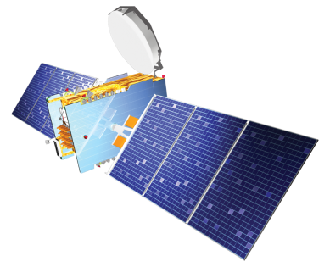

Opportunities for enhancing the Capacity
 | Growth need | Strategy
Telecom | On orbit capacity TV channel growth, HDTV, Mobile multimedia, Broadband, DMS needs Growing Bandwidth from 10 GHz to 1000’s GHz | Diversifying manufacture to industry, Enabling Commercial satellites, Larger spacecraft; Payload efficiency growth Collaborations
Earth Observation | One day turnaround for imaging anywhere and delivery, Needs of national GIS, Rapid and robust disaster support | Commercial satellites for high resolution segment; International Collaboration

Slide 8

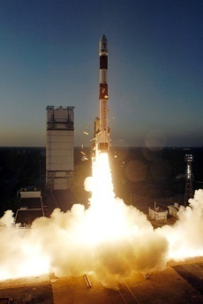
Enhancing the Capacity
 | Growth need | Strategy
Weather | Monitoring extreme weather, Improving prediction accuracy and range | Increasing industry role in spacecraft platform manufacture
Navigation | Replacement needs Global coverage | Ground segment & service development Collaboration; Batch production in industry
 | Heavier lift/ lower cost Higher production | Greater role of industry/ licensed manufacture
L V

Slide 9


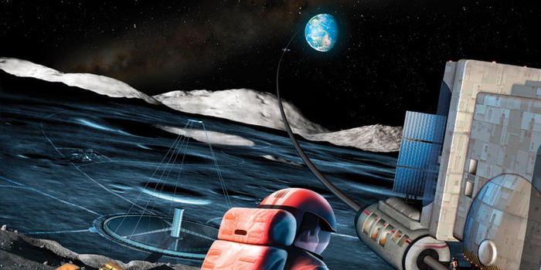
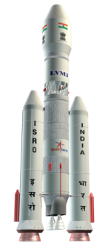
INDIA IN SPACE 2030
New Missions
  EO Submeter
  Thematic constellations
  Advanced telecom sats
  Planetary exploration/ resources
  Navigation (towards global service)
  Human Space Flight / Space Transport
Robust build up of space infrastructure and private satellites, collaborations
 | Now | 2030
India’s Space Economy | 2% of global | 10% (Target as a major space power)
Public expenditure(% of GDP) | 0.04% | 0.25%

Slide 10
Trade opportunities
Export opportunities
Satellites and satellite equipment /subsystems
Launch services
Transponder lease
Remote sensing data and downlinks
Ground equipment and Mission support
Import needs
Space qualified parts
Manufacturing and Test Equipment
Launch services
Transponder capacity
Space Insurance services
Mission support
User terminals

Slide 11
CHALLENGES

Slide 12

Policies need renewals &updates
Govt. Procurement policies
Technology transfer/ consultancy
Use of ISRO facilities by industry
Production lines in industry
Long term buy back commitments
Satcom Policy / regulation
Remote sensing / GIS policy
Innovation funding

Slide 13
Varying risk levels & policies to be flexible
MARKET | Private Sector( PS) | Pvt Sector/ PPP | Mostly Public/ Govt
LOW POTENTIAL | SATELLITE MANUFACTURE | SPACE TOURISM, CREW MODULES; CARGO FERRY | HUMAN SPACE FLIGHT, SPACE STATIONS
MEDIUM POTENTIAL | MICRO/ SMALL SATS; ONBOARD EQPT | NAVIGATION EQPT, HTS SATELLITES, LAUNCH VEHICLES | ROBOTS, ROVERS, LANDERS PLANET. EXPL.
HIGH POTENTIAL | SATELLITE SERVICES; CONTRACT MANUFACTURE | BROAD BAND; HIGH RES IMAGES LBS | SPACE SYSTEMS FOR NATIONAL SECURITY
RISK LEVELS AND GESTATION | LOWER | MODERATE | HIGHER

Slide 14
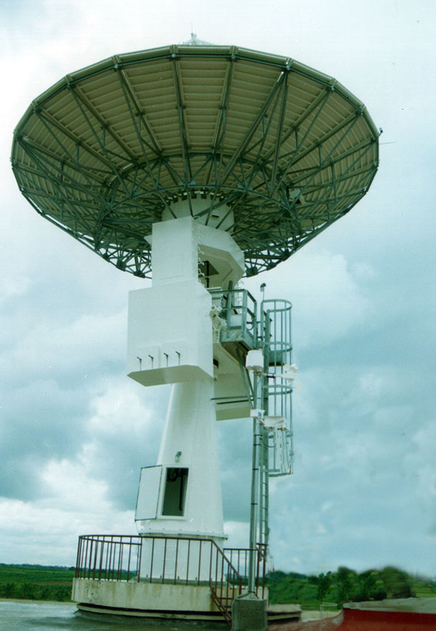
Ground segment challenges
EARTH STATIONS, VSATS
TT&C
DIRECT TV RECEPTION EQUIPMENTS
NAVIGATION CHIPS
BROADBAND RECIEVERS
LAUNCH FACILITIES
…….
STANDARDS, TECHNOLOGIES, COMPETITION, LATE ENTRY CHALLENGES

Slide 15
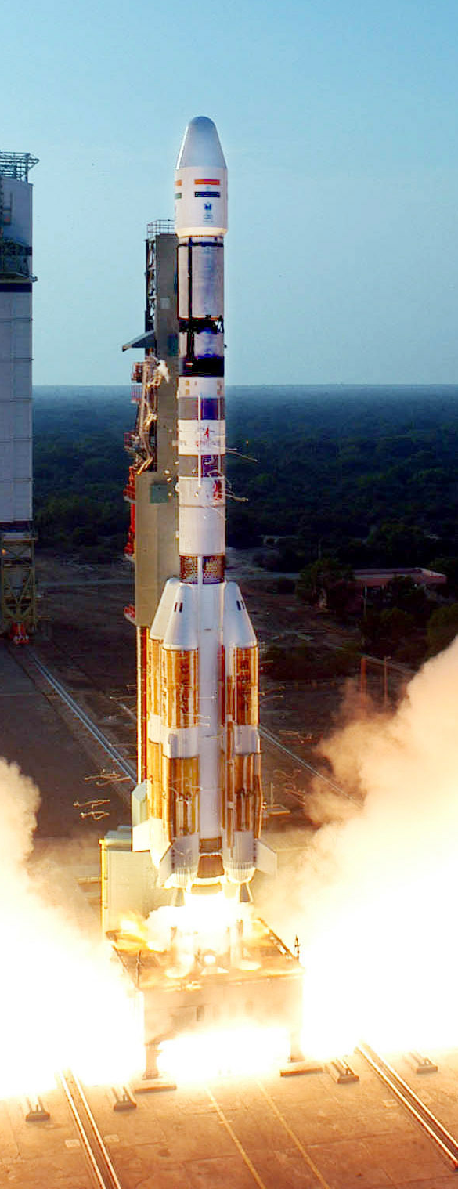
Launch services Challenges
Low Volumes: Govt & Industry perceptions; Dual use/ MTCR concerns
Risk sharing partners??
Uneven competition;
Investments and Gestation for Turn key manufacturing (consortium)
Policy challenges:
Authorization for launches - Evolving transparent procedures
Ensuring Technology safeguard obligations
Positioning safety and Insurance obligations
Assumption of liabilities by the state

Slide 16

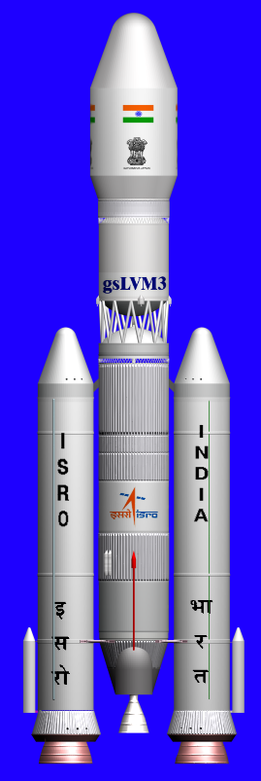
Launch services potentials 2
Policy/ legal challenges (Contd):
Policies reg Trade in launch services, assistance to industry
Government procurement guidelines
Policy on the use of government facilities
Balancing sustainability and competition in business
Risk financing
International collaboration
Contracting the industry for developmental projects

Slide 17
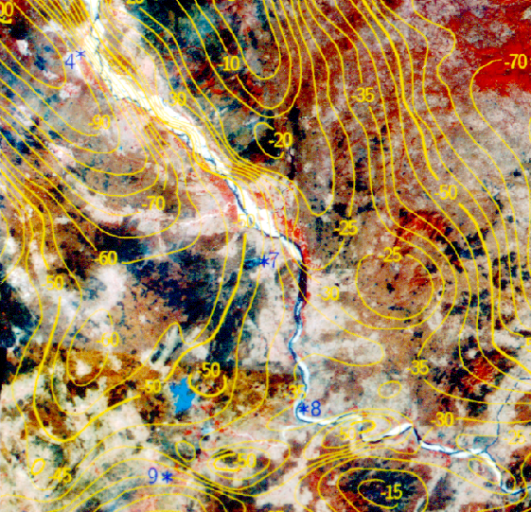
Remote sensing/GI -challenges
Access to data and Global competition
Achieving Parity with global policies
Meeting developmental needs as well as national security interests
Protection of privacy
Reforms in regulation of Aerial surveys – UAV regulations
Common regulator & service provider –“conflict of interest “ resolution
IMPLEMENTING NATIONAL GIS POLICY

Slide 18
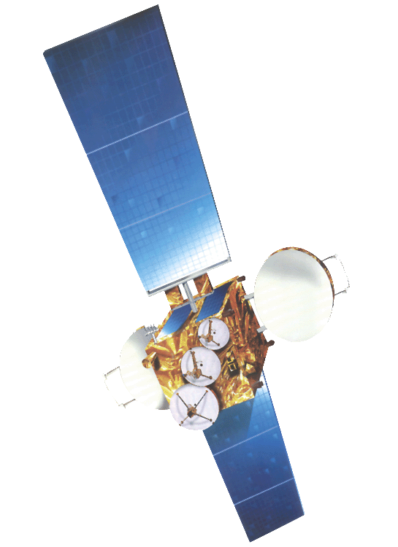
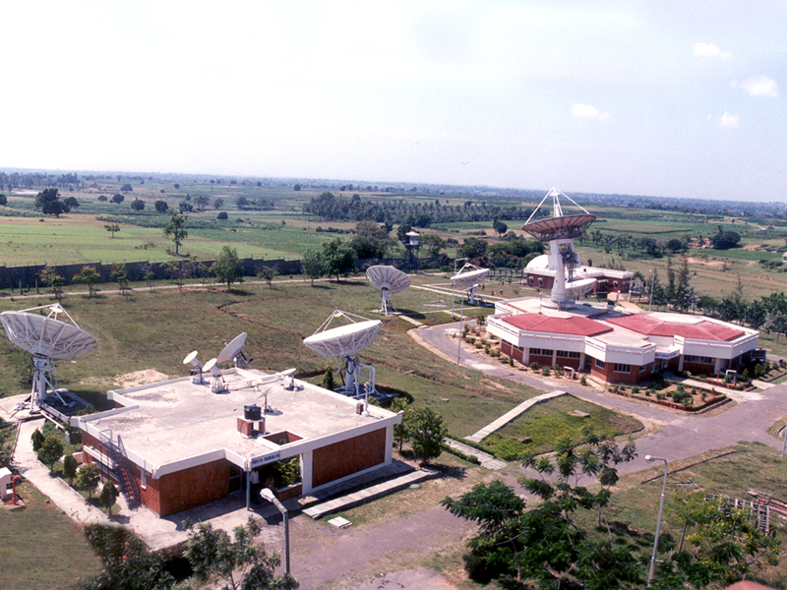
Satellite Communications infrastructure - challenges
  Attracting investments by private sector
  Private sector yet to enter infrastructure area
  Large satellite platform technologies to be taken up
  Manufacturing capacity for tapping external markets is to be expanded
  Coverage outside India

Slide 19
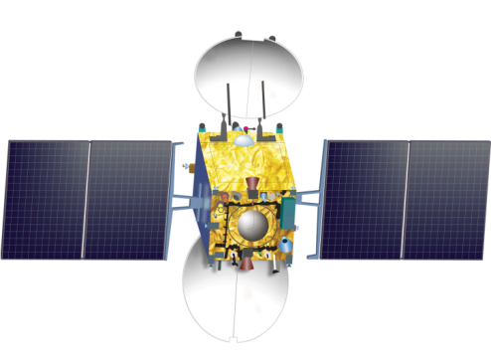
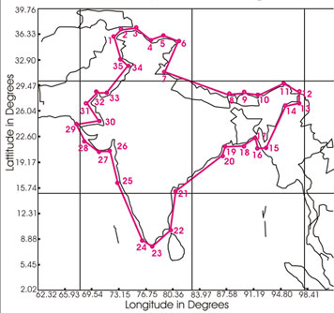
Satellite Communications services
  Orbit /spectrum access facilitation for private sector. Enhancing these resources for national needs
  Incentives for infrastructure development by private sector
  Establishing Indian registered satellites –improving policy implementation process
  Independent regulatory role and removing conflict of interests

Slide 20
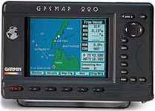
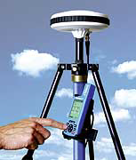


Satellite based positioning
                Need for ground segment industry for Indian satellites
                Strengthening policies to expand Indian Satellite Navigation to Global (service) level
                Enable nationwide positioning service
                Establishing access policies for civil and security

Slide 21
Call for an all round renewal
Independent regulators
R&D, tech support to industry from ISRO
Use of govt owned facilities
Priorities and incentives
Risk coverage & Liability regimes
Govt. procurement
Technology safeguards
Collab./ competition policies
Quality standards

Slide 22

Thank you

